Slide 1
Data Management CT051-3-M
Topic 4 – Data Preprocessing – PART 2

Slide 2
Topic & Structure of Lesson
Major tasks in data preprocessing
Data Integration
Data Transformation

Slide 3
Data Preprocessing
Why preprocess the data?
Data integration
Data transformation

Slide 4
Data Integration
Data integration:
combines data from multiple sources into a coherent store
Schema integration
integrate metadata from different sources
Entity identification problem: identify real world entities from multiple data sources, e.g., A.cust-id ≡ B.cust-#
Detecting and resolving data value conflicts
for the same real world entity, attribute values from different sources are different
possible reasons: different representations, different scales, e.g., metric vs. British units

Slide 5
Handling Redundant Data in Data Integration
Redundant data occur often when integration of multiple databases
The same attribute may have different names in different databases
One attribute may be a “derived” attribute in another table, e.g., annual revenue
Careful integration of the data from multiple sources may help reduce/avoid redundancies and inconsistencies and improve mining speed and quality

Slide 6

Data Integration:
A Strategy for the Future

Slide 7
Data Preprocessing
Why preprocess the data?
Data cleaning
Data integration
Data transformation

Slide 8
Data Transformation
One of the important factor to decide difference between powerful and useless model.
Two Objective:
Generate new variable - “Analytical/Modeling/Secondary Variables”
Fix any potential problems such as missing value and skewed variable distribution.

Slide 9
Examples of Analytical Variables
Average transaction value over a certain period (month, quarter, year)
Average number of transactions over a certain period (month, week, etc.)
Ratio of purchases from a specific product or product category to total purchases
Ratio of total purchases in a time period to available credit in the same period
Ratio of each purchase to the cost of shipment (specially when shipping costs are paid by the customer)
Ratio of number/value of purchased products to size of household

Slide 10
Examples of Analytical Variables Contd…
Ratio of price of most expensive product to least expensive product
Ratio of largest to smallest purchase in a time period
Ratio of total household debt to total household annual income
Ratio of largest income in a household to total household income
Ratio of available credit to household income
Average annual income per household member
Ratio of debt to available credit
Average percentage of used portion of credit over a certain period

Slide 11
Data Transformation
Smoothing: remove noise from data
Aggregation: summarization, data cube construction
Generalization: concept hierarchy climbing, values for numerical attributes, like age, may be mapped to higher-level concepts, like youth, middle-aged, and senior.
Feature Scaling
Normalization (Rescaling): scaled to fall within a small, specified range [0…1]
Mean Normalization
Standardization

Slide 12
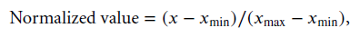
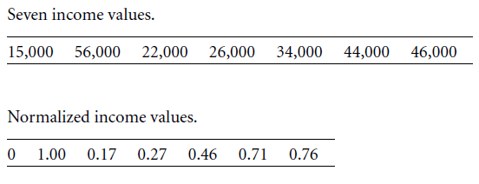
Data Transformation: Normalization
min-max normalization

Slide 13
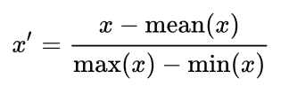
Data Transformation: Mean Normalization
Mean normalization:
Where, x is an original value, x' is the normalized value.

Slide 14
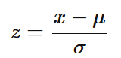
Data Transformation: Standardization
Standardization (or Z-score normalization or Mean Removal)
The features will be rescaled so that they’ll have the properties of a standard normal distribution with
μ=0 and σ=1
where μ is the mean (average) and σ is the standard deviation from the mean

Slide 15
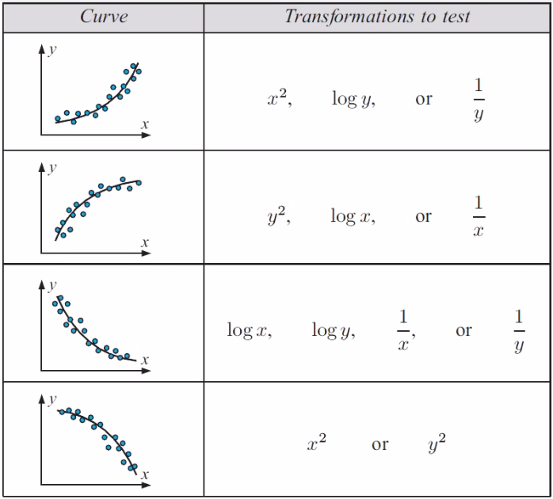
Data Transformation: Using Square, Log or Reciprocal

Slide 16
Changing the variable distribution
Changing the distribution of a variable, independent or dependent, can result in significant change in model performance.
Usually performed to uncover the relationships that were masked by the variable distribution.

Slide 17
Changing the variable distribution
Three methods for transformation (Continuous variable)
Rank Transformation
Box-Cox Transformation
Histogram

Slide 18
Rank Transformation
Simplest method – Valid ONLY for continuous variable
It just replace the values with Rank

Slide 19

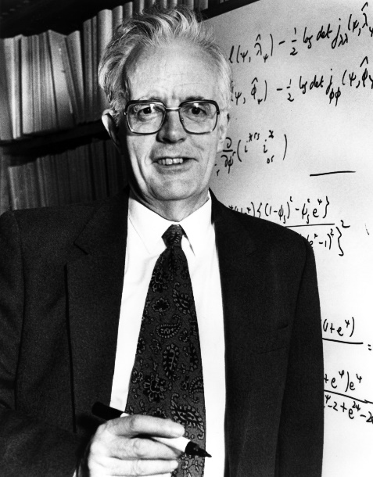
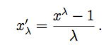
Box-Cox Transformation
George Box
David Cox
Attempts to transform a continuous variable into an almost normal distribution.
The Box-Cox transformation of the variable x is also indexed by λ, and is defined as

Slide 20
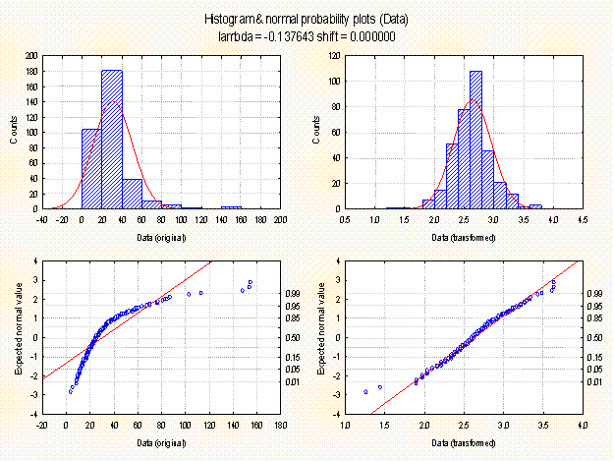
Box Cox Transformation - Example
Notes:
http://documentation.statsoft.com/STATISTICAHelp.aspx?path=Spreadsheets/Spreadsheet/UsingSpreadsheets/BoxCoxTransformations/BoxCoxTransformationOverviewandTechnicalNotes
Lambda values between -5 and +5,

Slide 21
Further Reading
http://onlinestatbook.com/2/transformations/log.html

Slide 22
Question & Answer Session
Q & A

